Slide 1
L6 Group-1 Pitch 1
Caitlin White, Connor Wilby, Jamie Chandler and Jordan Marks

Slide 2
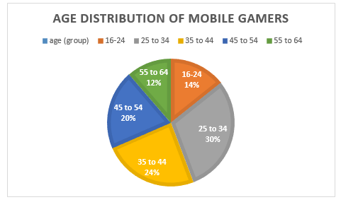
Demographic
Age: 25-34
Gender: Female
Source: http://www.realitymine.com/myth-busting-mobile-gaming-demographics/

Slide 3
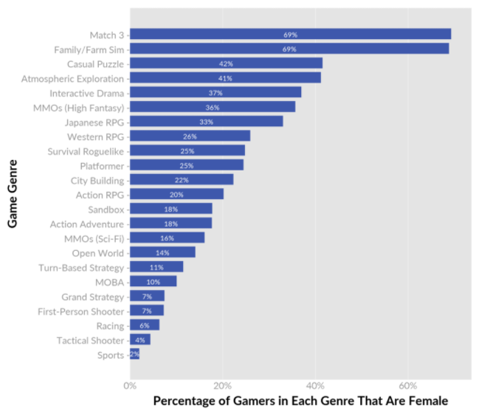
Psychographic
Doesn’t have much time to play games
Enjoys going online in the evenings to use social networks.
Enjoys shorter game sessions

Slide 4
Idea 1- Hex Switching

Slide 5
Idea 1- Platform and Genre
Platform: Mobile and Tablet
Genre: Puzzle
Duration: Up to 5 minutes

Slide 6
Idea 1- Game Loop
Level start
Swap tiles
Complete level
Earn rewards
Hard Fun:
Accomplishment
Strategy
Clear Goal
Soft currency- Power ups
Hard currency- Cosmetics

Slide 7
Idea 1- Challenges
Creating an unbroken chain of hexes
Using different hex types to reduce the number of moves this takes
Optimisation game

Slide 8
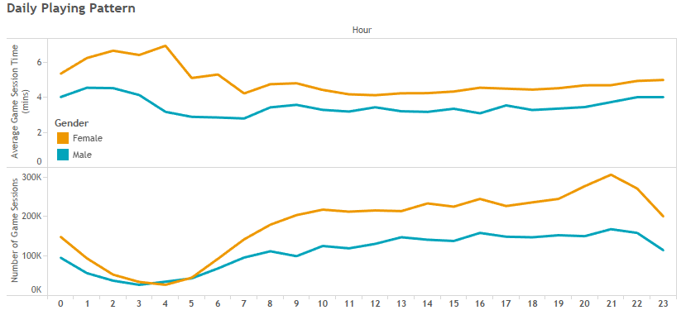
Idea 2 – Platform and Genre
Platform: Mobile and Tablet
Genre: Puzzle
Duration: Up to 2 minutes
Source: http://www.realitymine.com/myth-busting-mobile-gaming-demographics/

Slide 9
Idea 2 – Game Loop
Level start
Complete level
Earn rewards
Direct character through level to the goal
Tap to change direction of tiles
Soft Currency – Power Ups
Hard Currency – Cosmetics
Hard Fun:
Accomplishment
Strategy
Clear Goal

Slide 10
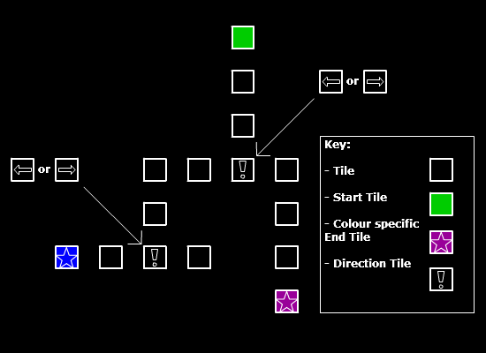
Idea 2 - Challenges
Directing characters to matching goal platform
Multiple characters to direct
Varying Speed
Level Complexity
Varying Platforms

Slide 11
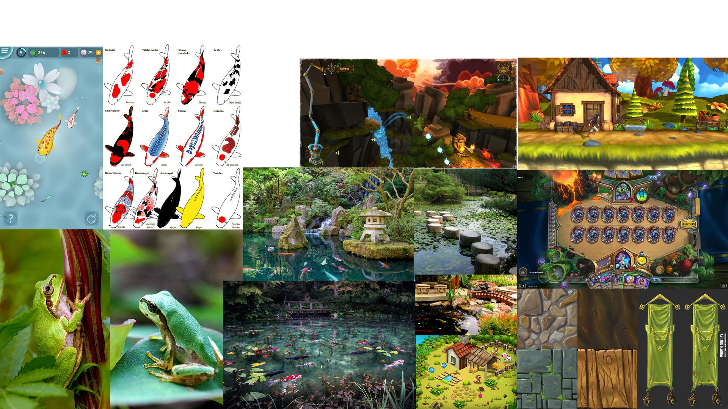
Idea 2 – Moodboards and Style Guide

Slide 12
Idea 3- Platform and Genre
Platform: Mobile and Tablet
Genre: Puzzle
Duration: 1 minutes per life with up to 6 mins of play when all lives are used at once

Slide 13
Idea 3- Game Loop
Use a Life
Make as many words as you can in a minture
Earn rewards
Player’s have a minute to come up with as many words as they can using the given letters
Soft Currency – Power Ups
Hard Currency – Refill your lives
Hard Fun:
Accomplishment
Strategy
Clear Goal

Slide 14
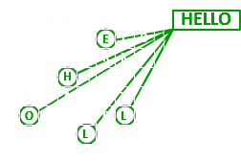
Idea 3 - Challenges
Mental challenge
Varying amount of letters
Letter based point scoring

Slide 15

Idea 3 – Moodboards and Style Guide

Slide 16
Questions?

Slide 17
http://www.ampush.com/blog/the-fastest-growing-mobile-gaming-audience-women/
http://www.realitymine.com/myth-busting-mobile-gaming-demographics/
http://www.adweek.com/brand-marketing/infographic-how-mobile-use-varies-across-generations-166426/
https://www.nyfa.edu/student-resources/learning-from-the-best-puzzle-games/
https://vungle.com/blog/2015/04/27/the-6-rules-of-a-hit-puzzle-game/
https://www.polygon.com/2017/1/20/14337282/games-for-women-and-girls

